Slide 1
Blockchain for Home Services

Slide 2
What problem are we trying to solve?
In 2011, consumer protection agencies reclaimed $147 million in construction fraud on behalf of homeowners
Estimated 20,000 to 100,000 scammers attempt to defraud homeowners each year
Homeowners and contractors do not trust each other.
There is no service that facilitates that trust and protects both parties.

Slide 3
How we fix it.
Leverage smart contracts to provide an escrow service that protects both homeowners and home improvement professionals.
Homeowner: verify that promised work is completed before transferring funds.
Contractor: ensure that they are paid after work has been verified.
Makes many existing fraud tactics ineffective.

Slide 4
Building a Business
5% commission fee of smart contract value
Assuming similar user base as HomeAdvisor, we estimate a revenue of $35-million.
Platform can be expanded to include other features, such as sharing home history with potential buyers.
Home improvement and maintenance is estimated to be a $700 Billion industry

Slide 5
Case for Blockchain

Slide 6
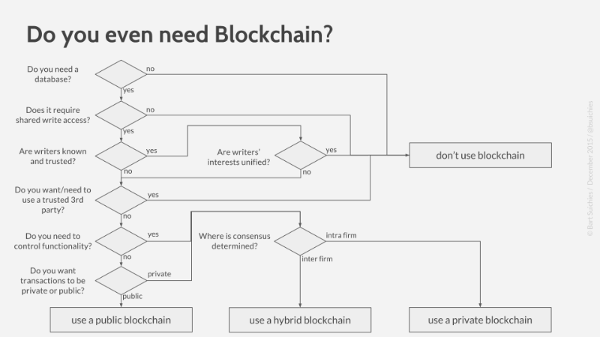
Suichies Model

Slide 7
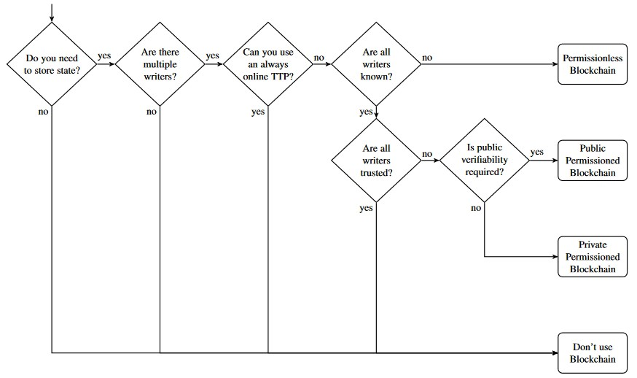
Wüstl and Gervais Model

Slide 8
Case for Blockchain
Nearly immutable
Notes:
Nearly immutable
Recall the chain of blocks that maintain accuracy in a link of transactions
Can imagine how it’s useful for
Homeowner
Know if contractor is reliable and gets work done
Contractor
Knows if homeowner is sound and pays money on time
Better than just database because...

Slide 9
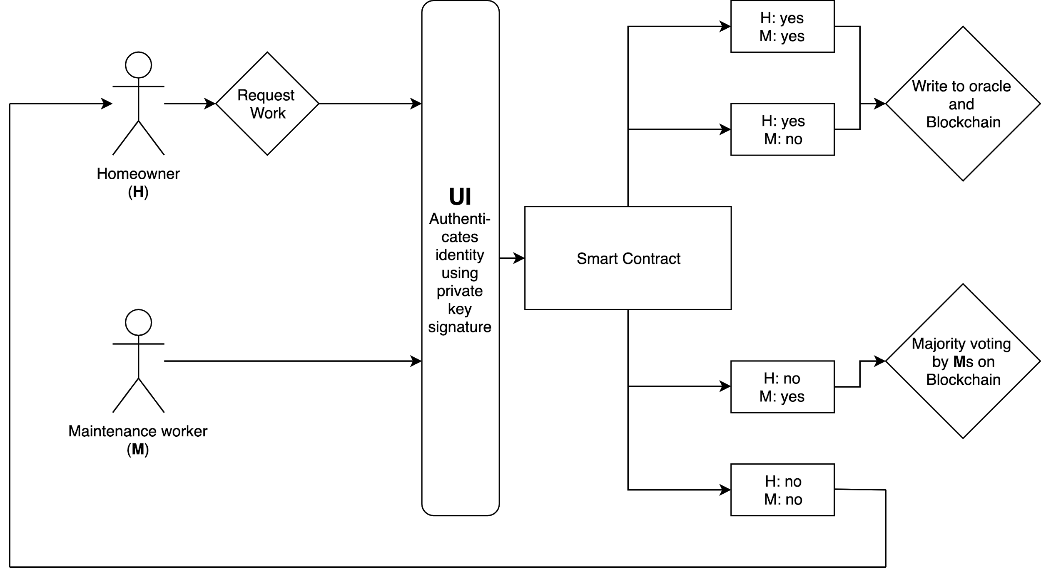
Technology and Architecture
Notes:
More information about voting

Slide 10
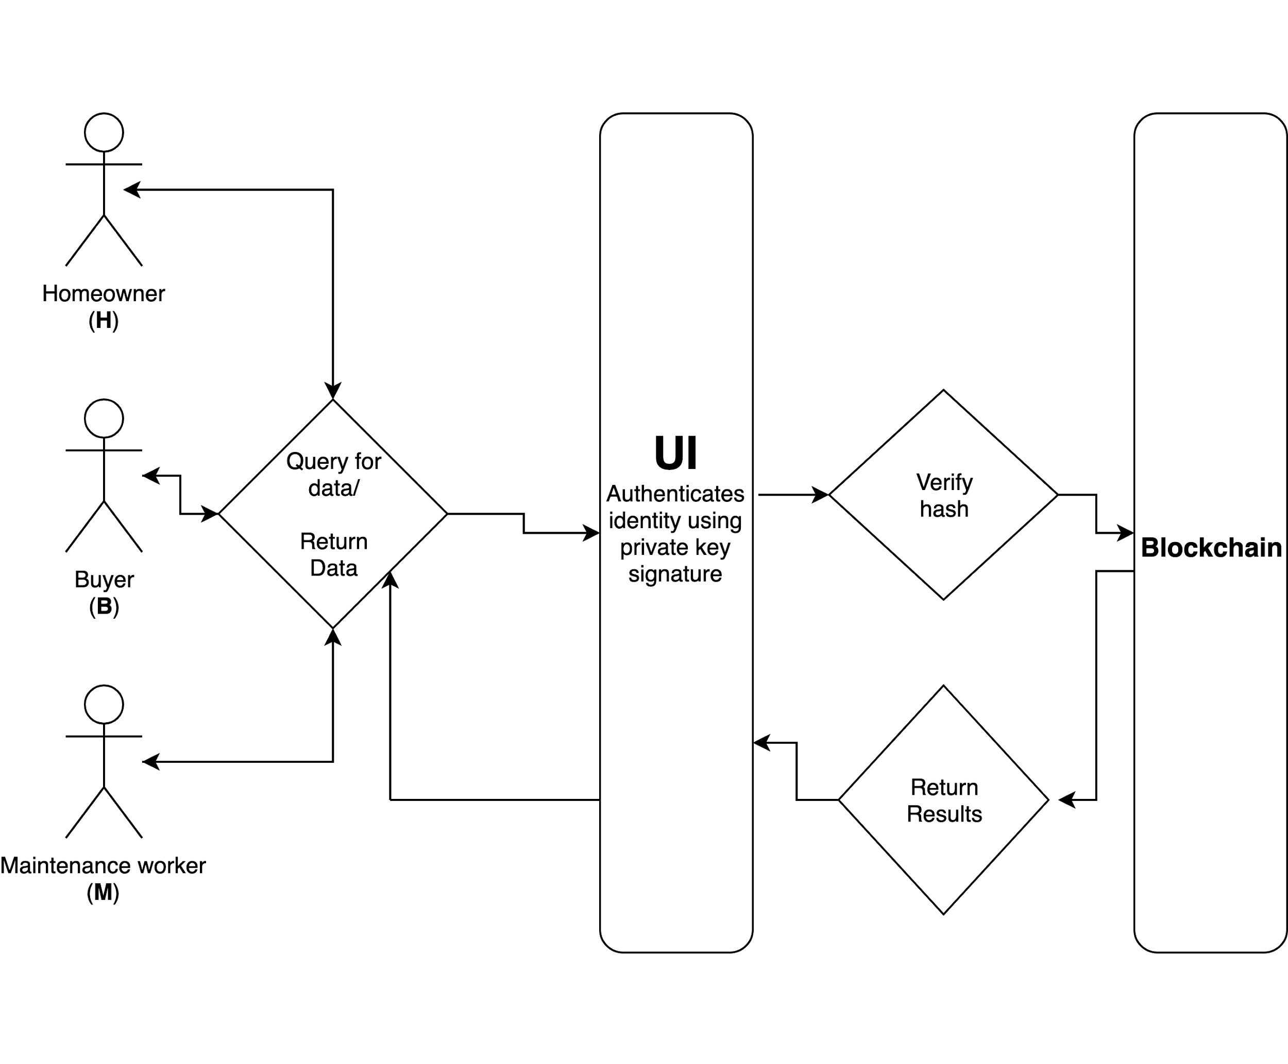
Technology and Architecture

Slide 11
Challenges
Incentive for user voting may not be sufficiently strong
It may take a long time to obtain enough votes for a confident or statistically significant decision, impacting time to transfer money.
Images and videos may not provide enough or the correct kind of data to make an informed decision.
Misjudgements based on voting may be extremely expensive for homeowner or professional.

Slide 12
Competitors
No solution that protects both homeowners and contractors
However, many online marketplaces that try to connect homeowners with professionals
ANGI HomeServices: $1 billion revenue, holds 12 brands including HomeAdvisor, Angie’s List and Handy
Value proposition: we pre-vet contractors and protect both parties with smart contracts.

Slide 13
Thank You

